Slide 1
Let’s End (The Use of Low Bar) Poverty
Mercatus Center, PPE, September 21 2022
Lant Pritchett
Oxford BSG, LSE SPP, HKS BSC
(with some post-presentation edits)

Slide 2
Overview of my argument
For the last 30 years development economics has experienced a massive Gresham’s Law phenomena in which bad economics--poverty analysis with low bar poverty lines--has driven out pre-existing better economics, (variants on) standard Social Welfare Functions.
The only distinguishing feature of poverty measures as normative assessment or as goal/objective (versus the large class of SWF) is that above the poverty line the derivative of poverty wrt is exactly zero.
Therefore poverty analysis is only defensible, either as economics or more broadly, morally (in a Kantian/Golden Rule sense), if we/you/one using “poverty” as a goal is comfortable with the claim that the gain to a valid normative assessment of income gains is well approximated by zero at an income marginally above the poverty line.
At any of the commonly used “low bar” poverty lines (such as “dollar a day” which is now $1.90/day, or nutritional needs lines or even small multiples of those lines (such as “two dollars a day”) this assertion is (orders of magnitude) empirically indefensible and, I would argue, morally obscene as it asserts that you (the user of “poverty”) value the income gains infinitely less than the people who experience those gains do or than you would if they were your income gains.

Slide 3
Outline of the paper
How did we get to “dollar a day” poverty? (a brief intro to poverty measures and poverty lines)
The four inevitable analytical mistakes of any P(LBPL):
Mistake 1: There is no line
Mistake 2: The gains to any plausible definition of HH ell-being are not well approximated by zero—and for that LBPL are off by at least an order of magnitude.
Mistake 3: P(LBPL) treats income gains that are nearly equal as infinitely different.
Mistake 4: P(LBPL) treats income gains that are very different as exactly the same
These analytical mistakes contribute to big mistakes in development practice

Slide 4
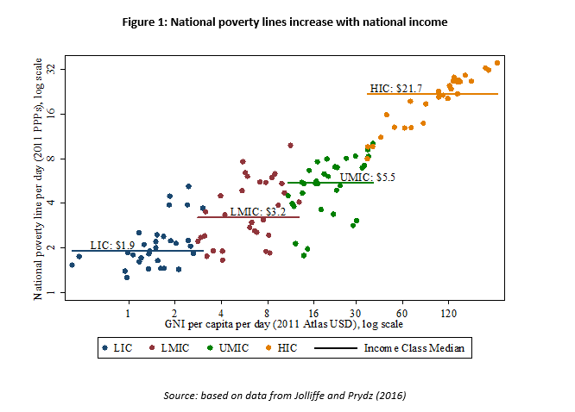
(Too) Brief Intro to Poverty and LBPL
Analytical basis
Updated version showing that the LBPL are simply the poverty lines of the poorest countries (note the median for each group is used)
In connection with the World Bank World Development Report 1990 on poverty the report needed a “headline” poverty number
The Foster Greer Thorbecke (1984) class of measures had a poverty line
The poverty line was deliberately chosen to be the lowest possible/feasible/credible poverty line
The analytical justification for “dollar a day” as the line was an “S” curve in national poverty lines and roughly poverty line of the poorest countries was chosen (Ravallion, Datt, and Van de Walle 1991)
Note that this “method” of choosing a global LBPL need not produce a line with any particular desirable properties.
Ferreira and Sanchez-Paramo 2017

Slide 5
This one specific measure, the “dollar a day poverty line, FGT headcount” took on a life of its own
Enshrined in the MDGs
The World Bank changed its objectives to reflect it
Campaigns like “Let’s End Poverty” sprung up
Often what was meant by “poverty reduction” was this measure of “extreme poverty”

Slide 6
Mistake 1: There is no line
There are sometimes lines in natural phenomena
H20 (water) undergoes transitions across states from solid to liquid to gas at specific temperature thresholds (0 and 100 C at atmospheric pressure)
Around black holes there is an “event horizon”
In network phenomena there are key network metrics such that dynamics are radically different above and below the threshold
David Lynch’s great scene in the movie Mulholland Drive “No Hay Banda” in which one hears music while the announcer says “There is no band”
Just because people talk about a poverty line and provide measures of poverty at a poverty line does not mean there is a non-arbitrary poverty “line”

Slide 7
Mistake 1: “There is no line” in human wellbeing
Measure of individual/HH wellbeing either subjective (e.g. ‘utility’) or physical (e.g. child nutrition, basic infrastructure (sanitation, electricity), etc.
What a “line” at a poverty line would look like (very different slopes/dynamics on either side of a “line” range of incomes
What the actual relationships actually look like, pretty smooth (not necessarily linear, could be log-log, level-log, polynomial) but smooth
HH income (per person, per EA)

Slide 8
Mistake 1: “There is no line” in poverty dynamics
What one might mean by a “poverty line” is that here is a “poverty trap” such that the future income dynamics of those below a poverty line are different than those above a poverty line.
However, with the advent of an increasing number of panel data sets it became clear that “poverty” was a condition of HHs that they transited in and out of rather than a “characteristic” of HHs (like being left-handed) (e.g. Ravallion and Chen for China).
Moving Out of Poverty (Narayan-Parker, Pritchett, Kapoor 2009) examined 10 year transitions in income status in 17 regions and found that transitions out of poverty were similar to movements upwards of the income group just above the non-poor and that transitions into poverty were often as common as transitions out
Not to mention the phenomena of very rapid reduction in P(LBPL) in rapidly growing countries like China, Vietnam (and formerly Indonesia and others) belied the notion that pre-existing poverty was to any great extent people in a person/HH specific “poverty trap” dynamic (as opposed to living in a poor, slowing growing, place)
Some fraction of poverty are “chronic poor” who are persistently poor but these are typically a small fraction of the total poor and are “trapped” by characteristics (e.g. widowhood without support) rather than poverty (low-income) itself.

Slide 9
Mistake 2: The gains to wellbeing from income gains at a LBPL are not well approximated by zero
If you are a trained economist you should already be convinced as:
Deaton (2008) and Stevenson and Wolfers (2008) find that self reported wellbeing and income are roughly log-linear all the way up
Stevenson and Wolfers (2013) find that the increment to wellbeing is often (typically) higher for those above $15,000 than below

Slide 10
Mistake 2: Evidence 2 for dWB/dY(LBPL)>>>0, food shares
A typical way in which “cost of basic needs” poverty lines are constructed (see, for instance, Pradhan, Suryahadi, Sumarto and Pritchett 2003 for a fully consistent algorithm of this type) is:
Estimate the cost of reaching 2,000 calories per person at the food basket consumed by those at the poverty line and that is the FPL
Add to the FPL either (b.1) the spending on non-food of those whose total income is the FPL (lower) or (b.2) the spending on non-food of those whose actual food spending is the FPL
Either way, this method for setting a LBPL guarantees the food share of consumption spending is very high (both average and marginal)
So to use a LBPL you have to assert: “I am comfortable with a valuation of zero of the income gains of HHs who are spending more than half of those income gains on food” This is ridiculous.

Slide 11
Mistake 2: (new) Evidence 3 for dWB/dY(LBPL)>>>0, evidence from the association of GDPPC and “basics”
Suppose you were not convinced by subjective wellbeing
Suppose you were not convinced by anything involving HH expenditures.
I am going to create an index of “basics” of material wellbeing based on physical indicators (e.g. child mortality, malnutrition, education, sanitation) and show that the increment to this index of basics from gains to GDPPC is very high well above the poverty line

Slide 12
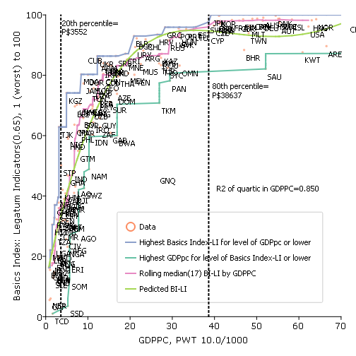
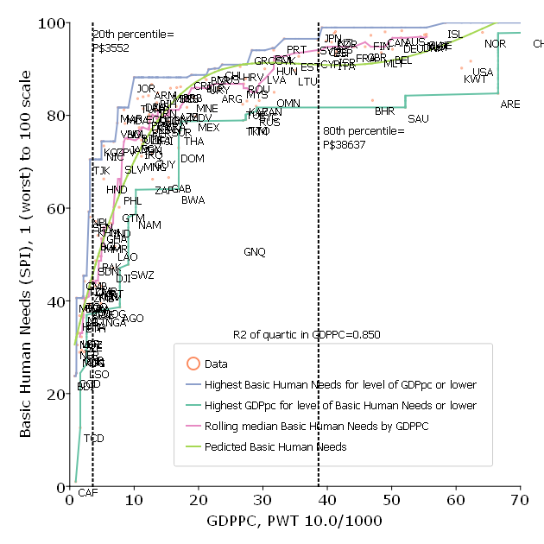
No matter how one constructs an multiple indicator index of “basics of material human wellbeing” the association with GDPPC is strong, non-linear, necessary and sufficient
Source: Pritchett with Lewis (2022)

Slide 13
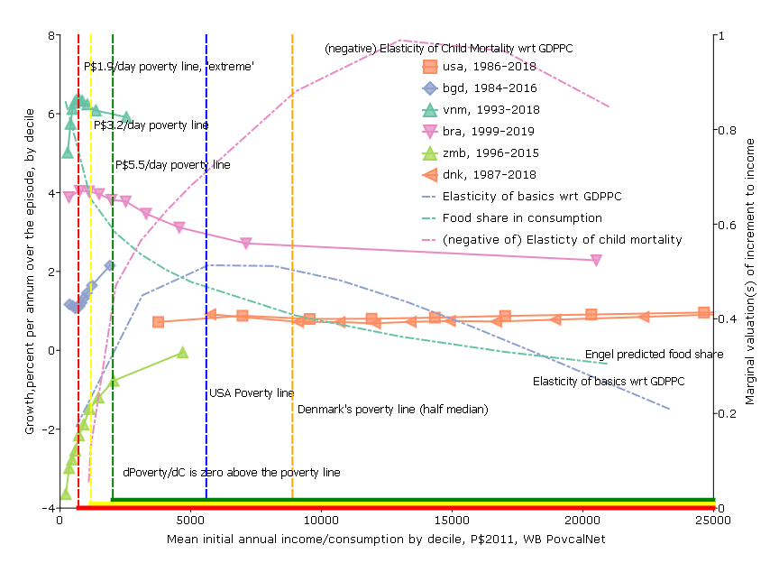
What is the “marginal gain to wellbeing” in a “development” objective function? Standard poverty analysis says it is zero above the poverty line—that it is near zero at any World Bank used poverty line is completely nuts—it could only be true at a very high line (well above the poverty lines of OECD countries)
The idea that the normative objective of ‘development’ is “reduction of poverty” and that “poverty” is defined such that the gain from additional income/consumption above the poverty line is zero at a very low level of consumption is both theoretically, practically and morally obscene.
Even at the World Bank’s “high” poverty line of P$5.5/day: (i) the food share of consumption is around .6, (ii) the elasticity of basics wrt GDPPC is rising,(iii) the elasticity of child mortality wrt to consumption expenditures is rising.
Source: Recent blog of mine

Slide 14
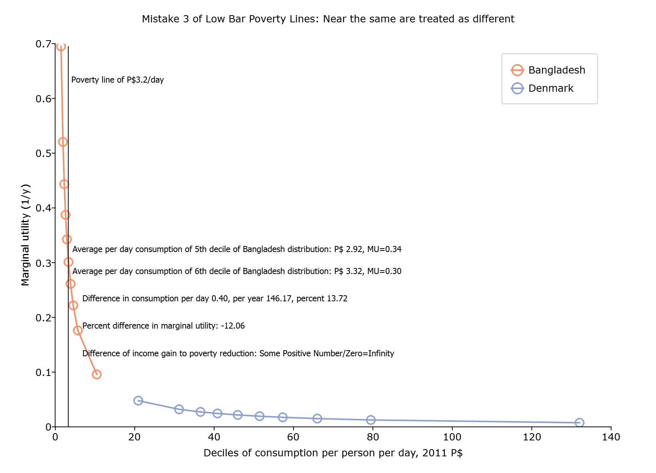
Mistake 3: People who are nearly identical are treated as infinitely different (because some count at exactly zero)

Slide 15
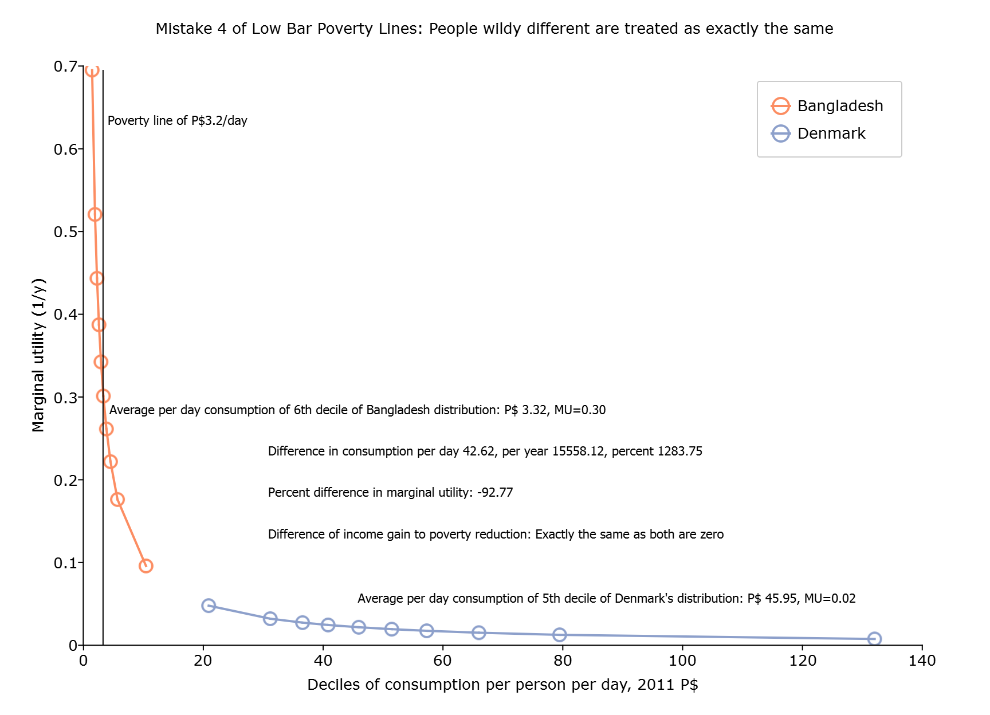
Mistake 4: Treat very different HHs (in income and hence in MU) exactly the same (because both count at exactly zero)

Slide 16
Big Picture Practical Mistakes in the Development Industry That Low Bar Poverty Lines Facilitate
The shift from “national development” (four-fold transformation at country level) to “programmatic” efforts to improve human wellbeing…when “national development” matters
…and in particular a belief that targeted programs are “equally” (or substantially) important to poverty reduction as economic growth
Poverty analysis has led to the belief there is a group called “the poor” and that actions to help specifically these people are a key element of development actions…but this is false (poverty is a condition, not a characteristic) and, at LBPL, cannot be a democratically sustained organizing objective for government

Slide 17
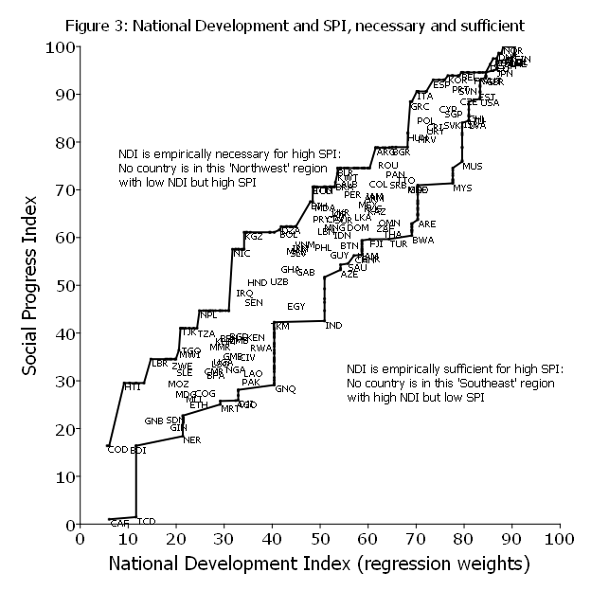
The premise of development practice was that the fourfold transformation of development: higher productivity, greater administrative capability, more responsive governments and more equal legal treatment would lead to higher human wellbeing.
This is and remains true, in spades. National development is empirically necessary and sufficient for omnibus measures of human wellbeing
Source: Pritchett 2022

Slide 18
J-PAL is saying things like: “growth is not enough” and programs are “equally important”
Two things
This statement is empirically false (by at least two orders of magnitude, the correct proportion is more like .5 percent than 50 percent—see next slide) and is based on zero evidence (pretty striking for an organization that claims it wants to promote the use of rigorous evidence)
This statement is only possible if one uses LBPL to (deliberately) make Mistake 4 versus a reasonable SWF. That is, “specific targeted social programs” cannot be anywhere near as important as growth to improvements in human wellbeing overall if one puts any weight on the gains of those at all levels of income because then the absolute gains of those in the distribution above the poverty line matter in ways that ‘targeted’ programs cannot make a different to.
JPAL:
For good reason, economic growth has long been a top policy goal for countries around the world. But for millions of people living in poverty, growth is not enough. Specific, targeted social programs based on rigorous empirical evidence are equally important to prevent people from being left behind.

Slide 19
Not just “some of” or “most of” but “essentially all” (in cross-section) and “nearly all” (in long episodes) of reduction in income/consumption poverty is associated with levels or long episode changes in the median
Source: Pritchett 2020

Slide 20
Table 1: An “extreme poverty” goal is extremely exclusionary—gains to the middle income groups in nearly every country in the world are not included as progress by a goal of eradicating extreme poverty
Country Name (All middle income groups are excluded by an extreme poverty goal in the countries in bold) | Pop’l | Gains to citizens at the specified percentile of the distribution included in a “poverty” goal?
 |  | 80th | 60th | 40th | 60th | 60th
 |  | Extreme Poverty ($1.25 per day) |  |  | USA poverty line $15 per day | Half of US poverty line
China | 1357.4 | No | No | No | Yes | Yes
India | 1252.1 | No | No | No | Yes | Yes
Indonesia | 249.9 | No | No | No | Yes | Yes
Brazil | 200.4 | No | No | No | Yes | No
Pakistan | 182.1 | No | No | No | Yes | Yes
Nigeria | 173.6 | No | No | Yes | Yes | Yes
Bangladesh | 156.6 | No | No | Yes | Yes | Yes
Russian | 143.5 | No | No | No | Yes | No
Mexico | 122.3 | No | No | No | Yes | No
Philippines | 98.4 | No | No | No | Yes | Yes
Ethiopia | 94.1 | No | No | No | Yes | Yes
Vietnam | 89.7 | No | No | No | Yes | Yes
Egypt | 82.1 | No | No | No | Yes | Yes
Iran | 77.4 | No | No | No | Yes | Yes
Turkey | 74.9 | No | No | No | Yes | No
Democratic Republic of Congo | 67.5 | Yes | Yes | Yes | Yes | Yes
Thailand | 67.0 | No | No | No | Yes | Yes
South Africa | 53.0 | No | No | No | Yes | Yes
Tanzania | 49.3 | No | Yes | Yes | Yes | Yes
Colombia | 48.3 | No | No | No | Yes | Yes
Total population of countries in which gains to the "middle class" (by each definition—80th, 60th, 40th) is excluded by an "extreme poverty" goal | 4640 | 4572 | 4523 | 4193 | 0 | 541
Percent of the population of world's 20 largest developing country whose middle class (by various definitions) is excluded by an "extreme poverty" goal |  | 98.54% | 97.48% | 90.37% | 0% | 11.66%

Slide 21
P(LBPL) cannot be the basis of a country strategy
The previous slide shows that you cannot pretend to have a democratically determined country-owned strategy with P(LBPL) at its center as this would imply a government telling more than half the population they are not central to the overall government strategy.
The point of that is not that governments will adopt P(LBPL) as their strategy, but just that the gap between what governments/citizens in “the South” want to do and what development organizations support gets had to bridge with “kinky development” focused on low-bar goals (e.g. Pritchett 2015 or video of presentation).

