Slide 1
State Capability:
Dos, Do nots, and Donuts
Lant Pritchett
Oxford Blavatnik School of Government
April 24, 2021
Indian School Public Policy, Delhi

Slide 2
Overview of the presentation, what I am saying (based on new research and ideas)---and how it is different from the RW (received wisdom)
  Do: pay attention to state capability as it is central to achieving higher levels of human well being outcomes
    (RW: Focus on policy and program design, worry about “what” not “how”)
  Do not: Seek to adopt “best practice”—as if often destroys state capability
  (RW: Seek out and adopt international “best practice”)
  Donuts: Many existing state organizations are “donuts” in that they have lost their “core” and are now shells or zombie organizations
    Do nots about donuts: Reforms on the periphery (e.g. HR, IT/MIS, Procurement) or “compliance” drivers cannot fix the core
      (RW: Consultants/IT/outside-in-top-down can help make for more effective organizations)
    Dos about donuts: PDIA (problem driven iterative adaption)—rebuilding a core requires a focus on priority problem within reach
      (RW: “Solutions” create solutions)

Slide 3
Do: Focus on state capability
Do
Conventional wisdom
Organizational capability is the ability to induce the agents of an organization to take the state-contingent actions that promote the legitimate normative objectives of the organization.
Measured in a broad cross national way state capability matters, a lot, for everything about human well-being
With weak state capability (de jure) laws, policy and program design might not matter at all
“What” to do is the key question for “policy makers”
Program design can be:
  Formed independently of actual capability
  Based on strictly “logistical” capabilities (e.g. top-down, “thin input”, compliance)
Or worse,
“More” is the key—e.g. spend more to get more (e.g. “invest” in X where “invest” means “spend”)

Slide 4
1 | 3 | 12 | 58
Social Progress Index | Basic Human Needs | Nutrition and Basic Medical Care | Undernourishment (% of pop.), Deaths from infectious diseases (deaths/100,000), Child stunting (% of children), Maternal mortality rate (deaths/100,000 live births), Child mortality rate (deaths/1,000 live births)
 |  | Water and Sanitation | Unsafe water, sanitation and hygiene attributable deaths (per 100,000 pop.), Populations using unsafe or unimproved water sources (%), Populations using unsafe or unimproved sanitation (%)
 |  | Shelter | Usage of clean fuels and technology for cooking (% of pop.), Access to electricity (% of pop.), Household air pollution attributable deaths (deaths/100,000)
 |  | Personal Safety | Traffic deaths (deaths/100,000), Political killings and torture (0=low freedom; 1=high freedom), Perceived criminality (1=low; 5=high), Homicide rate (deaths/100,000)
 | Foundations of Wellbeing | Access to Basic Knowledge | Access to quality education (0=unequal; 4=equal), Women with no schooling, Gender parity in secondary attainment (distance from parity), Primary school enrollment (% of children), Secondary school attainment (% of population)
 |  | Access to Information and Communications | Access to online governance (0=low; 1=high), Media censorship (0=frequent; 4=rare), Internet users (% of pop.), Mobile telephone subscriptions (subscriptions/100 people)
 |  | Health and Wellness | Access to quality healthcare (0=unequal; 4=equal), Access to essential services (0=none; 100=full coverage), Premature deaths from non-communicable diseases (deaths/100,000), Life expectancy at 60 (years)
 |  | Environmental Quality | Greenhouse gas emissions (total CO2 equivalents), Particulate matter, Biome protection, Outdoor air pollution attributable deaths (deaths/100,000)
 | Opportunity | Personal Rights | Political rights (0=no rights; 40=full rights), Freedom of expression (0=no freedom; 1=full freedom), Freedom of religion (0=no freedom; 4=full freedom), Access to justice (0=non-existent; 1=observed)
 |  | Personal Freedom and Choice | Property rights for women (0=no right; 5=full rights), Vulnerable employment (% of employees), Corruption (0=high; 100=low), Early marriage (% of women), Satisfied demand for contraception (% of women)
 |  | Inclusiveness | Equality of political power by socioeconomic position (0=unequal power; 4=equal power), Equality of political power by social group (0=unequal power; 4=equal power),Equality of political power by gender (0=unequal power; 4=equal power), Discrimination and violence against minorities (0=low; 10=high), Acceptance of gays and lesbians (0=low; 100=high)
 |  | Access to Advanced Education | Quality weighted universities (points), Citable documents, Women with advanced education (%), Years of tertiary schooling

Slide 5
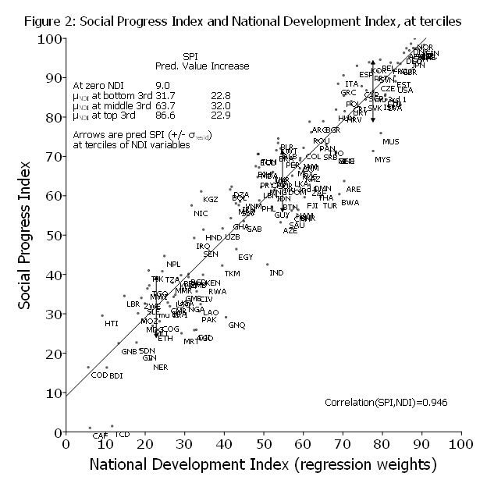
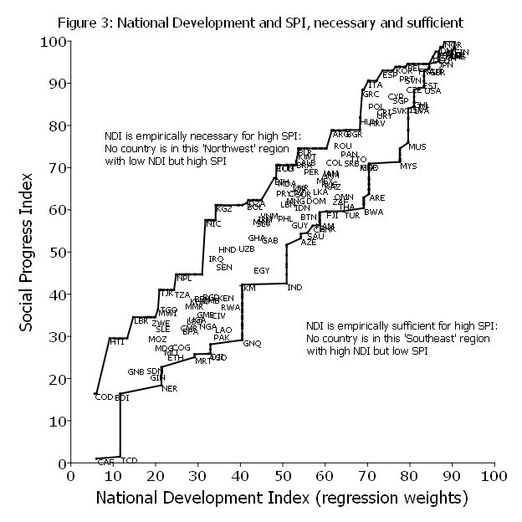
National Development is a productive economy, a capable state, and a responsive government and I am not saying just “national development matters” I am saying that for many important wellbeing outcomes national development is all that matters (the rest is driven by these three factors)

Slide 6
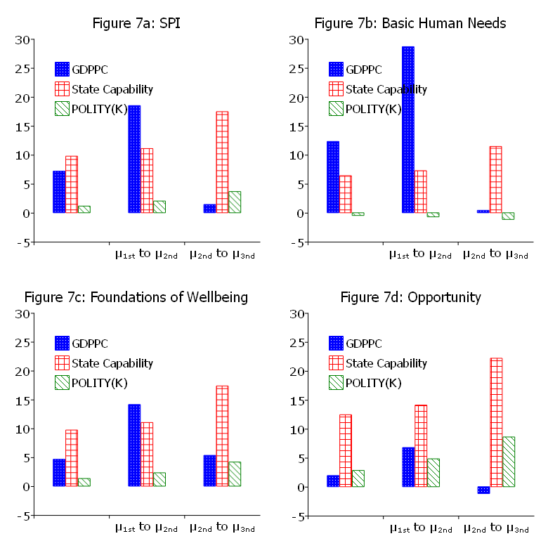
Economic growth more important that state capability for basics at low levels of income…but state capability matters for improving all outcomes at all levels of development
Source: Pritchett (2021, first draft finished yesterday)

Slide 7

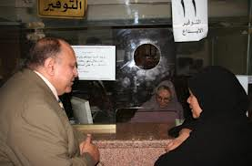

Does “policy” matter at all for outcomes? An example where every country has the same policy produces 0 and 100 percent
Includes not just Somalia and Myanmar but Tanzania, Ghana, Nigeria, Egypt, Russia, Mongolia, Cambodia, Honduras, Fiji, etc.
Source: Chong et al 2014

Slide 8
Does “policy” or “capability” matter more (at the margin) for improving outcomes (e.g. health, schooling, tax collection, infrastructure, security, environmental quality)? It depends—illustrated with an entirely hypothetical graph
The “capability” view is that the range of what is possible to implement at low capability is quite narrow and increasing capability is the key to better outcomes (“how “ not “what”)
The “policy” view is that within the range of policies that could be implemented at existing capability much better outcomes could be achieved by choosing a more effective policy what not how)
LATE(δ)
LATE(δ)

Slide 9
Do not: Seek to adopt “best practice”

Slide 10
The “best practice” fantasy and fallacy is to choose as a policy something that is very far from existing capability
Capability is here
LATE(δ)

Slide 11
Some empirical research on one specific indicator (time to get a construction permit) allows a comparison across countries of the “de jure” and “de facto” times
Doing Business Indicators
Enterprise Survey
The number of days it would take to get a construction permit (for a commercial warehouse) if one were to follow the law.
De jure measure of the time for regulatory compliance.
One observation per country per year
Ask firms who actually built something how long it took them to get the permit
De facto measure of how business is done

Slide 12
Around the world there are massive differences between actual reported days (de facto) and the DB days (de jure)
The typical median Doing Business is 190 days
Roughly 1/3 of firms report less than 15 days, another 1/3 15 to 45, only 1/3 report more than 45 and the 90th percentile is 145 days

Slide 13
Sudan: DB (de jure) is 270 days but 93.5 percent (of 108) firms report taking less than 15 days

Slide 14
In highly regulated, weak capability states, making the law stronger reduces compliance
Source: Kar, Pritchett, Roy and Sen 2019

Slide 15
What are the “facts” is an interplay between the organizational/institutional pressures on agents to declare the fact facts to be the juridically relevant administrative fact versus pressures on agents in the implementation chain to declare favorable facts
Pressures to be accurate
Fact Facts: the “objective”
reality
Administrative or juridical facts
on which the policy mapping
to actions of agents depends
Organizational capability to control the facts
Pressures to create a “deal” and declare a favorable fact (independent of reality)

Slide 16
Two dimensions of organizational (“army”) capability: in “theory” (on the parade ground) and in “practice” (when the other side is trying to kill you)
Ability to inflict damage
on the enemy
Maximum stress the force can sustain
Army
Sharply non-linear dynamic
of army “capability” under engagement
Stress—from “army” to “mob”
Spartans
Paper
Tiger
Disorganized Mob
Battlefield stress (e.g. fog
of war, casualties)

Slide 17
Driver’s licenses in Delhi: What is the “policy” for getting a driver’s license?
Studied people getting driver’s license
Completely Typical de jure policy prove identity, residence, age, and driving competence
De facto policy: hire a tout and the driver’s examination is waived
>2/3 of those who got a license (and avoided test of competency) by hiring a tout had no driving skills at all
Source: et al, Hanna, et al 2009

Slide 18
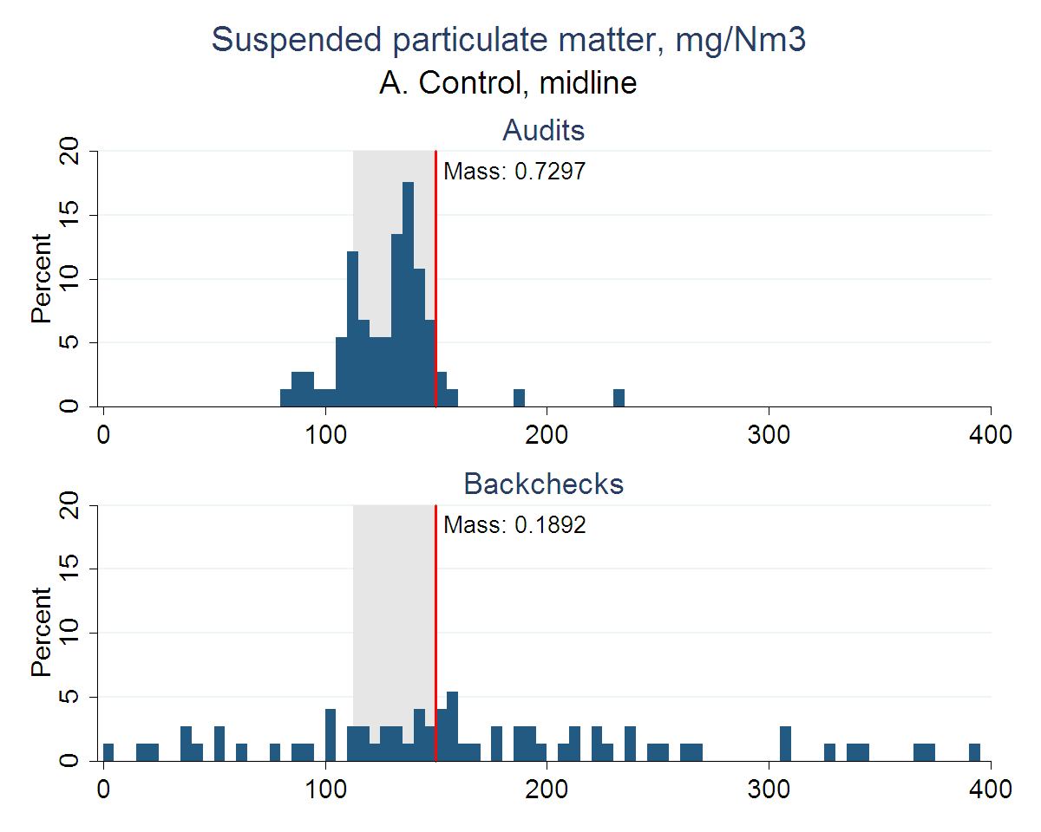
Firms provided third-party environmental audits were complete fiction: even when reality was better
Duflo, Greenstone, Pande, and Ryan 2013
Notes:
Modified audits much closer to true pollution reading on average . . .
i. Auditors were misreporting pollution under status quo auditing system
1. Reported that many plants were polluting just under the limit for emissions

Slide 19
Massive cheating on routine (non-high-stakes) learning assessment is the norm
Source: Singh, 2020

Slide 20
During the course of the field experiment to motivate nurses
to attend their clinics with “best practice” design in Rajasthan…
But “presence”
went down too
“Absence” went down
“Exemptions” went up—fiction replaced fact
Source: “Putting a Band-Aid on a Corpse: Incentives for Nurses in the Indian Public Health Care System” (with Esther Duflo and Rachel Glennerster), Journal of the European Economic Association 6(2-3), pp. 487-500, April 2008.

Slide 21
Again, there are two completely different views of the dynamics between “policy” and the actual practices of organizations: ‘Big jump” and “narrow corridor”

Slide 22
Simple, uniform, convergence dynamics (linear in discrepancy) suggests “big jump”—make the law/policy the best you can when you can and practice catches up to policy
Observed stable cross national relationship
Policy
In these dynamics the approach is obvious: do as much as you can on policy whenever you can and practices will follow
Practices

Slide 23
“Narrow Corridor” dynamics—the “off equilibrium” equations of motion are not constant over the space
… but a big jump in a “good” direction makes things worse by creating a dynamics of non-compliance
Observed cross national relationship (stable)
Policy
In these dynamics a series of small jumps inside the “narrow corridor” get you there (the hard slog)
Practices

Slide 24
Observed cross national relationship (stable)
“Strong” de jure laws to do good things (e.g. taxation, land use planning, environmental regulation, etc.)
“Gold plated” best practice or “evidence first” approach
A “capability first” approach, like PDIA, to build capability by delivering results, good laws that lead to good outcomes are the result of innovations in good practices
State capability for implementation

Slide 25
The inexorable trap dynamics of “good” law, low capability for implementation, crappy outcome”
The advocates for the “good thing” will never in a million years advocate for a relaxation of the “beautiful” de jure law (and will be supported by the “experts” from abroad who live in the “narrow corridor” dynamics)
The powerful private actors in the economy are (in one way or another) free from the negative consequences of the beautiful law as they have “deals” that are available. These powerful actors do not want stronger “organizations” or “institutions” or enforcement
Politicians are almost certainly making money/gaining resources from the differential enforcement of the law and if the law actually could be complied with this would go away.
Any individual firm can choose to lobby/take action either to (a) get themselves exempted from the consequences of the “beautiful” law (stay under the radar, pay off enforcement, make political connections) or (b) form a coalition to change the law.

Slide 26
The dos and do nots of donuts: Once organizations are in low capability trap dynamics (are hollow in the middle, like a donut) then many initiatives that “work” for other organizations will be a waste of time and take time and attention into unproductive “isomorphic mimicry”

Slide 27
Effective organizations are effective from a “core” outward: The core is a combination of: (a) and overriding and shared purpose and (b) a set of technical practices believed by those in the organization to advance that purpose
IT (MIS)
Legal
Budget, Accounting
Finance
Human
Resources
Procurement
Purpose
Around the core are a variety of functional “services” to the core: HR (to bring and manage people), Procurement (to get what the people in the core need), IT (to keep track of data and information to make informed decisions), Budgeting/Accounting/Finance (to attract and use resource
Technical Practices

Slide 28
Organizations can lose their core and become a donut in two ways
IT (MIS)
Legal
Budget, Accounting
Finance
Human
Resources
Procurement
Purpose
Technical Practices
Lost purpose: a common and shared understanding of the purpose of the organization erodes either from the inside (loss of faith) or the outside (infection of other purposes)
Lost commitment to a set of effective technical practices: (a) situation changes so that technical practices are not longer effective or (b) organization was in fact wrong about what practices were effective

Slide 29
If an organization is a “donut” it becomes susceptible to “hijack” from inside or outside or both (e.g. used for other purposes—like channel rents to insiders or outsiders via corruption or just non-feasance (e.g. not showing up, indifference) of workers)
IT (MIS)
Legal
Budget, Accounting
Finance
Human
Resources
Procurement
Purpose
Technical Practices
Some type of virus or parasite fills the core

Slide 30
Do nots about donuts: “technical” fixes from the service functions from the outside that are “best practice” and attempt to drive organizations to “compliance” cannot fix an organization
Legal
Budget, Accounting
Finance
Procurement
Human
Resources
For example, “civil service reform” that looks to greater compliance with the processes with which peopled are hired (“meritocracy”), employed, evaluated, promoted cannot substitute for the core

Slide 31
“Outside in” organizational “reform” very often just produces the camouflage of isomorphic mimicry
Examples from education:
Madhya Pradesh implementation of “School Improvement Plans” (Muralidharan and Singh (2020).
Bano (2021) on School Based Management Committees in Nigeria
Widespread cheating in India (Singh (2020) and Indonesia (Berkout et al 2020)

Slide 32
“Deal with the Devil” (biometrics for attendance in Karnataka India) in primary health clinics
Source: Dhaliwal and Hanna 2014

Slide 33

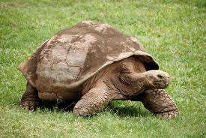
First pithy metaphor: You cannot beat a turtle to move
Dysfunctional organizations can survive external attack…by not moving from inside their shell
The head has to come out for the body to move

Slide 34
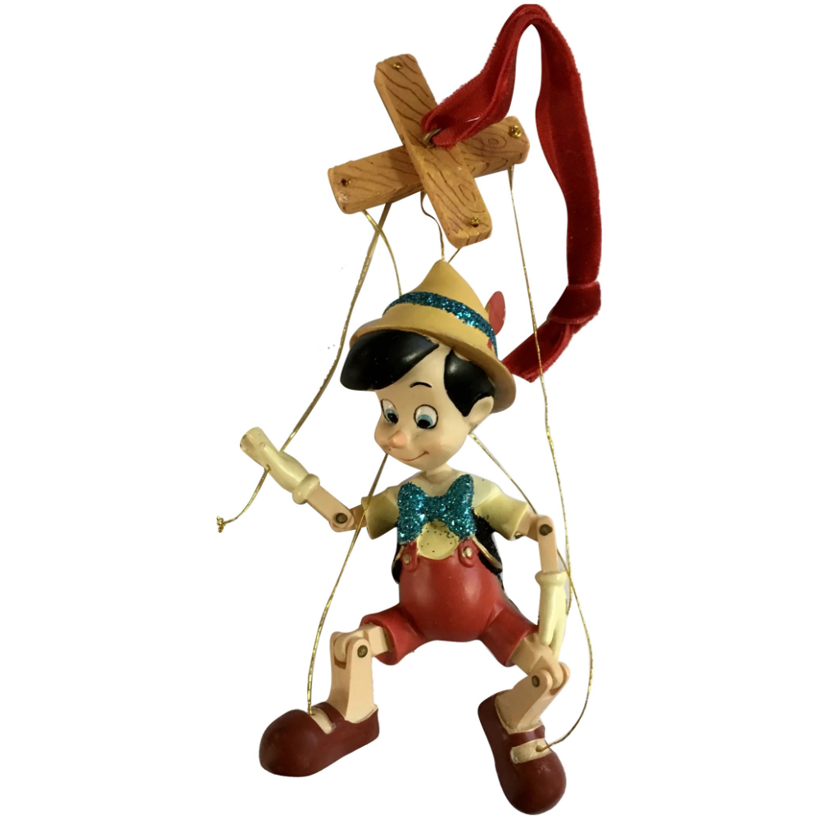
You don’t make Pinnochio from puppet into real boy by adding more strings…

Slide 35
Do of Donuts: Four Principles of PDIA
(Problem-Driven Iterative Adaptation)
Local Solutions for Local Problems
Pushing Problem Driven Positive Deviance
Try, Learn, Iterate, Adapt
Scale Learning through Diffusion

Slide 36
Dos, Do nots and Dos and Do nots of Donuts
Do focus on state capability at the organizational level
Do not adopt best practice
Donuts are hard to fix:
  Do not waste time and effort with “outside in” fixes
  Do pursue strategies that rebuild a commitment to purpose and effectiveness with “problem driven” approaches

