Slide 1
Coping with bad shocks: Lessons from growth dynamics
Lant Pritchett
Blavatnik School of Government, Oxford
2nd SANEM International Development Conference (SIDC) 2021
June 17, 2021

Slide 2
Outline of the presentation
Coping with bad shocks: the conventional wisdom based on rich country growth dynamics
A fundamentally different reality of growth dynamics for developing countries
  Facts
  Underlying theories
Are there different lessons?

Slide 3
Start with a question
Suppose I had 10 years of GDP data for a country from 100 years ago and I ran a simple trend regression on those 10 years of data and predicted the level of GDP 100 years ahead on the basis of that trend rate of growth.
How far off would you expect that 100 year ahead prediction to be (in terms of the absolute value of percent gap between prediction and actual)? {take a minute and write down your guess}

Slide 4
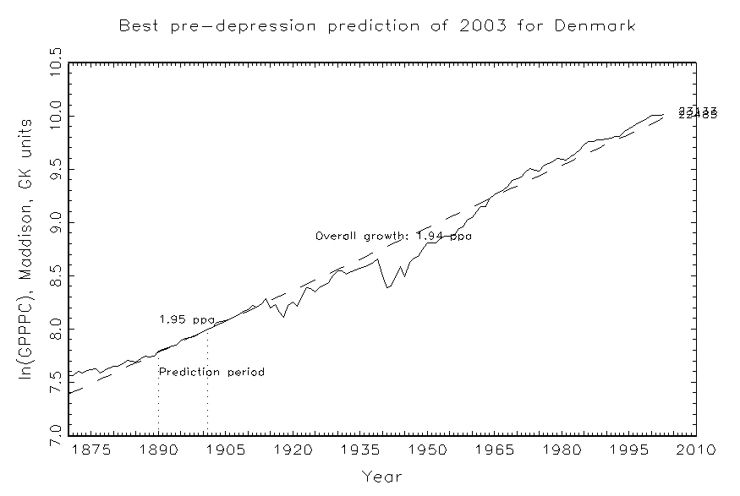
All happy families are alike…OECD countries have had amazing persistence of growth at about exactly 2 percent per capita for over 100 years and hence the future has been remarkably predictable
Source: Pritchett & Werker, 2013
Notes:
Lant: This is important as it rules out lots of silly talk about what is "necessary" for growth and is big fact for endogenous growth models. (I have graphs for usa and denmark showing the amazing predictive accuracy of 100 year ahead forecasts).
From the paper: One of the most striking economic facts is that one can predict OECD countries’ level of income 100 years ahead with remarkable accuracy. Figure 2 shows that using just data from 1890 to 1901 one can predict Danish GDP per capita in 2003 to within a few percentage points. One important implication is that Denmark’s growth has not accelerated or decelerated in over 100 years—its average growth from 1870 to 2003 was 1.94 percent, its growth from 1890 to 1915 was 1.93 percent, its growth 1980 to 2003 was 1.91 ppa. This lack of long-run growth acceleration across a century is true of the (old) OECD countries. This fact of long-run stable growth of the leaders itself rules out models that explain steady state growth as a linear function of anything that has grown steadily over time. As (Jones 1995) pointed out early on in the debate over endogenous growth models the fact that measures of education or knowledge or R&D have growth many fold over time while growth has been stable itself rules out many “first generation” endogenous growth models and makes the issue of growth and scale very difficult (Jones 1999; Jones 2005).

Slide 5
Even massive negative shocks for Denmark (like World War I, the Great Depression, and World War II) did not affect the long run level of GPDPC
Source: Pritchett & Werker, 2013
Notes:
Lant: This is important as it rules out lots of silly talk about what is "necessary" for growth and is big fact for endogenous growth models. (I have graphs for usa and denmark showing the amazing predictive accuracy of 100 year ahead forecasts).
From the paper: One of the most striking economic facts is that one can predict OECD countries’ level of income 100 years ahead with remarkable accuracy. Figure 2 shows that using just data from 1890 to 1901 one can predict Danish GDP per capita in 2003 to within a few percentage points. One important implication is that Denmark’s growth has not accelerated or decelerated in over 100 years—its average growth from 1870 to 2003 was 1.94 percent, its growth from 1890 to 1915 was 1.93 percent, its growth 1980 to 2003 was 1.91 ppa. This lack of long-run growth acceleration across a century is true of the (old) OECD countries. This fact of long-run stable growth of the leaders itself rules out models that explain steady state growth as a linear function of anything that has grown steadily over time. As (Jones 1995) pointed out early on in the debate over endogenous growth models the fact that measures of education or knowledge or R&D have growth many fold over time while growth has been stable itself rules out many “first generation” endogenous growth models and makes the issue of growth and scale very difficult (Jones 1999; Jones 2005).

Slide 6
The conventional wisdom: (i) shorten the shock (if one can), (ii) borrow to smooth consumption consequences
Green: no shock counter-factual
Red: Shock to output
Yellow: consumption with optimal response,
borrow to smooth consumption over time

Slide 7
What a “stable grower” (oecd happy family) looks like (introduction to set of pictures)

Slide 8
What are actual growth dynamics outside of the OECD
Mostly huge volatility within countries over time
Some long term very rapid growers
Some long term stagnaters

Slide 9
Booms and busts on a downward trend: Nigeria

Slide 10
Table 3: Examples of various “types” of transition dynamics, using 10 year (overlapping) growth rates
Country | Proportion of all 5 year (overlapping) growth rates in the growth categories:
 | <2 (collapse) | 2<g<0 (stagnation) | 0<g<2 Slow growth | 2<g<4 Moderate growth | 4<g<6 Rapid growth | 6<g Boom
Steady Moderate Growers (sum of category 3 and 4>.9) (27 of 120 countries)
TUR | 0.000 | 0.000 | 0.417 | 0.583 | 0.000 | 0.000
GBR | 0.000 | 0.000 | 0.208 | 0.792 | 0.000 | 0.000
COL | 0.000 | 0.000 | 0.708 | 0.292 | 0.000 | 0.000
Growth collapses (sum of category1 and 2 > .5) (21 of 120 countries)
HTI | 0.184 | 0.474 | 0.211 | 0.132 | 0.000 | 0.000
LBR | 0.571 | 0.179 | 0.036 | 0.036 | 0.071 | 0.107
SOM | 0.643 | 0.357 | 0.000 | 0.000 | 0.000 | 0.000
Boom and Bust (both the sum of growth states 1 and 2 and the sum of growth states 5 and 6 above .1) (30 of 120 countries) (not mutually exclusive with above, can include ‘collapses’ if they have booms)
BRA | 0.000 | 0.104 | 0.417 | 0.063 | 0.354 | 0.063
GHA | 0.070 | 0.209 | 0.419 | 0.163 | 0.023 | 0.116
PNG | 0.000 | 0.316 | 0.263 | 0.263 | 0.132 | 0.026
Rapid growth (sum of 5 and 6 above .5) (8 of 120 countries)
BWA | 0.000 | 0.000 | 0.132 | 0.184 | 0.342 | 0.342
KOR | 0.000 | 0.000 | 0.022 | 0.244 | 0.356 | 0.378
TWN | 0.000 | 0.000 | 0.000 | 0.128 | 0.298 | 0.574
Steady moderate growth (OECD and a few)
Stagnater/collapse
Boom and Bust
Rapid growers

Slide 12


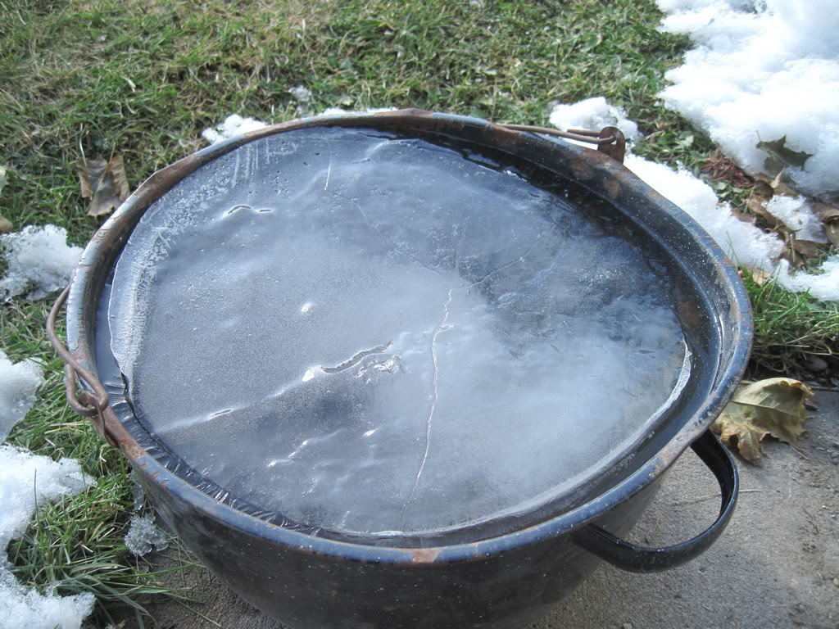
What will happen if I dump a bucket of water on my head?

Slide 13
“Developing” or “emerging market” countries have phase transitions
Everything about the standard macroeconomic decomposition into “trend” and “cycle” is unhelpful as growth is episodic
The phase transitions are often apparently sharp, discrete, and involve massive and persistent (longer than “business cycle”) changes in the underlying growth rate.

Slide 14
This means the “expected” outcomes from a shock are not confidence it returns to the previous trend path….but that anything can (and does) happen
Green: no shock counter-factual
Red: Shock to output (with reversion to previous trend)
Red Dotted: Shock leads to long term stagnation
Red Dashed: Shock leads to downward spiral
Red dot-date: Shock leads to response which causes even faster growth
Yellow: consumption with optimal response,
borrow to smooth consumption over time
A time of shock the N (10, 20) year ahead forecast is huge and hence the “borrow to smooth” strategy is highly uncertain

Slide 15
Two step procedure
Break every country in the world’s data into the statistically optimal timing of the episodes—when were the transitions?
(Looking for a break: Identifying breaks in growth regimes (http://ideas.repec.org/a/eee/jmacro/v38y2013ipbp151-166.html)
How rapid would have growth been without a break (building in regression to the mean in growth) and hence what were the gains and losses from growth accelerations/decelerations (“Trillions gained and lost”)

Slide 16
This produces for every country in the world a dating of the growth breaks and an estimate of the magnitude

Slide 17
Indonesia: Episode from 1967 to 1996, gain of 1 ln unit (actual 4.71 ppa vs 1.22 UCP for 29 years)

Slide 18
Worst 30 deceleration episodes
Worst 15 decelerations |  |  |  |  | Next worst 15 decelerations
Country | Period | Percent loss relative to UCP predicted | Percent loss start to finish, actual | Ratio end episode to all time low | Country | Period | Percent loss relative to UCP predicted | Percent loss start to finish, actual | Ratio end episode to all time low
Iran | 76-88 | -82.7% | -61.3% | 2.22 | mdg | 74-02 | -44.5% | -42.6% | 0.67
afg | 86-94 | -69.9% | -71.5% | 0.46 | cub | 84-95 | -44.1% | -29.9% | 1.37
mwi | 78-02 | -69.7% | -43.4% | 1.55 | gnb | 97-10 | -44.1% | -31.0% | 1.10
zar | 89-00 | -66.2% | -71.1% | 0.34 | uga | 69-80 | -43.2% | -35.0% | 0.84
irq | 79-91 | -65.4% | -77.1% | 0.48 | bdi | 92-00 | -40.7% | -35.5% | 1.35
jor | 65-74 | -63.1% | -34.0% | 1.52 | png | 73-84 | -39.6% | -28.3% | 1.23
tto | 80-89 | -61.6% | -45.6% | 2.38 | alb | 82-92 | -39.4% | -39.3% | 0.76
jor | 82-91 | -60.5% | -36.4% | 1.74 | zmb | 75-83 | -39.4% | -39.1% | 0.79
som | 78-10 | -57.7% | -46.7% | 0.62 | bgr | 88-97 | -39.4% | -21.4% | 2.09
nga | 76-87 | -56.7% | -48.4% | 0.88 | hti | 80-94 | -37.6% | -34.2% | 0.90
cmr | 84-94 | -51.3% | -41.9% | 1.06 | nic | 87-95 | -37.1% | -39.3% | 0.96
gab | 76-87 | -50.9% | -53.2% | 1.86 | gha | 74-83 | -36.6% | -34.8% | 0.94
sle | 90-99 | -50.2% | -50.3% | 1.10 | cog | 84-94 | -35.2% | -27.6% | 2.07
civ | 78-10 | -50.1% | -26.6% | 1.35 | mng | 82-93 | -35.0% | -33.9% | 1.08
rom | 86-94 | -47.4% | -30.8% | 3.82 | tcd | 71-80 | -33.8% | -35.4% | 0.72

Slide 19
Ghana—collapse 1974 to 1983, with dramatic recovery but to mediocre growth

Slide 20
Don’t confuse what is “good for long prosperity” with what is good for growth (in medium run)

Slide 21
Weak Institutions (whatever that means) Means Volatile Growth

Slide 22
Political shifts can end disastrously badly: Liberia’s political transition spilled into complete collapse from above SSA average to 1/5 of SSA average

Slide 23
Growth resilience: Spain has it (big shocks with big recoveries) vs Venezuela doesn’t (long negative slide from 1977 to 2002 with boom and bust after—and ToT deterioration after a boom turns it into chaos)
WEO October 2015 forecast past 2014
Source: PWT8.0 plus WEO (past 2010)

Slide 24
Two huge, fundamental, differences in the way understands the growth dynamics of non-OECD countries
In countries with generally weak capability for policy implementation one has “deals capitalism” not “rules capitalism” and the dynamics of growth in deals capitalism are completely different
The “capabilities” characterization of “structural transformation” versus the “production function” characterization the production possibilities

Slide 25
A big conjecture: The dynamics of deals capitalism
Deals Capitalism
Rules Capitalism
What happens to the typical firm/investor has little or nothing to do with neutral application of policies but is a firm/investor specific “deal”
“Closed ordered deals” can produce rapid growth rates—but block both “better institutions” and “creative destruction”
“Disordered deals” cannot protect property rights and hence lead to collapse
Dynamics of investor expectations of “state” transitions can produce wild swings in growth
What happens to the typical firm/investor is determined primarily by the neutral application of policies
This both “protects property rights” and “allows for creative destruction”—that is, does not protect incumbent “rights” to existing profits

Slide 26
Typology of “deals” environments
 | Open (deals depend on actions of agents (including influence activities) but not identities) | Closed (deals are available only to specific individuals/organizations—deals depend on identities)
Ordered (deals done stay done, predictable) | “Retail” corruption (e.g. driver’s licenses in Delhi) | “Cronyism” (e.g. Indonesia under Suharto)
Disordered (unpredictable what deals are available, deals have uncertain time horizon) | “Informal” sector in many countries | “Fragile” states

Slide 27
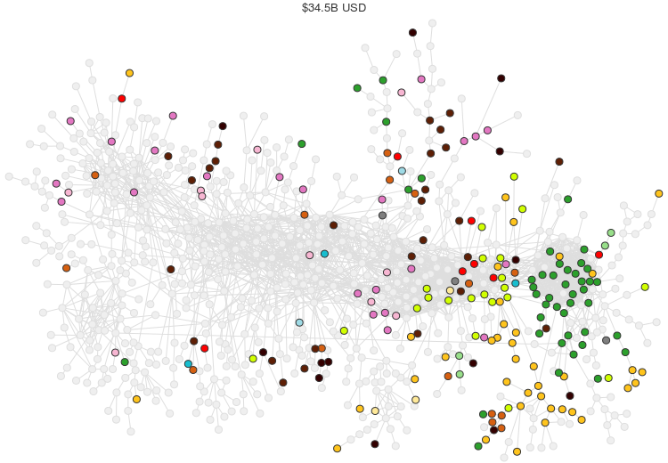
Egypt’s location in the product space in 2013

Slide 28
From “factors” to “capabilities” (Hausmann et al)
The export product space
The “complexity index”—that measures a countries location in product space
“Structural transformation” that sustains prosperity are moves that increase a country’s complexity
Complex products are the result of recipes requiring many capabilities—especially those that are collectively produced and non-traded

Slide 29
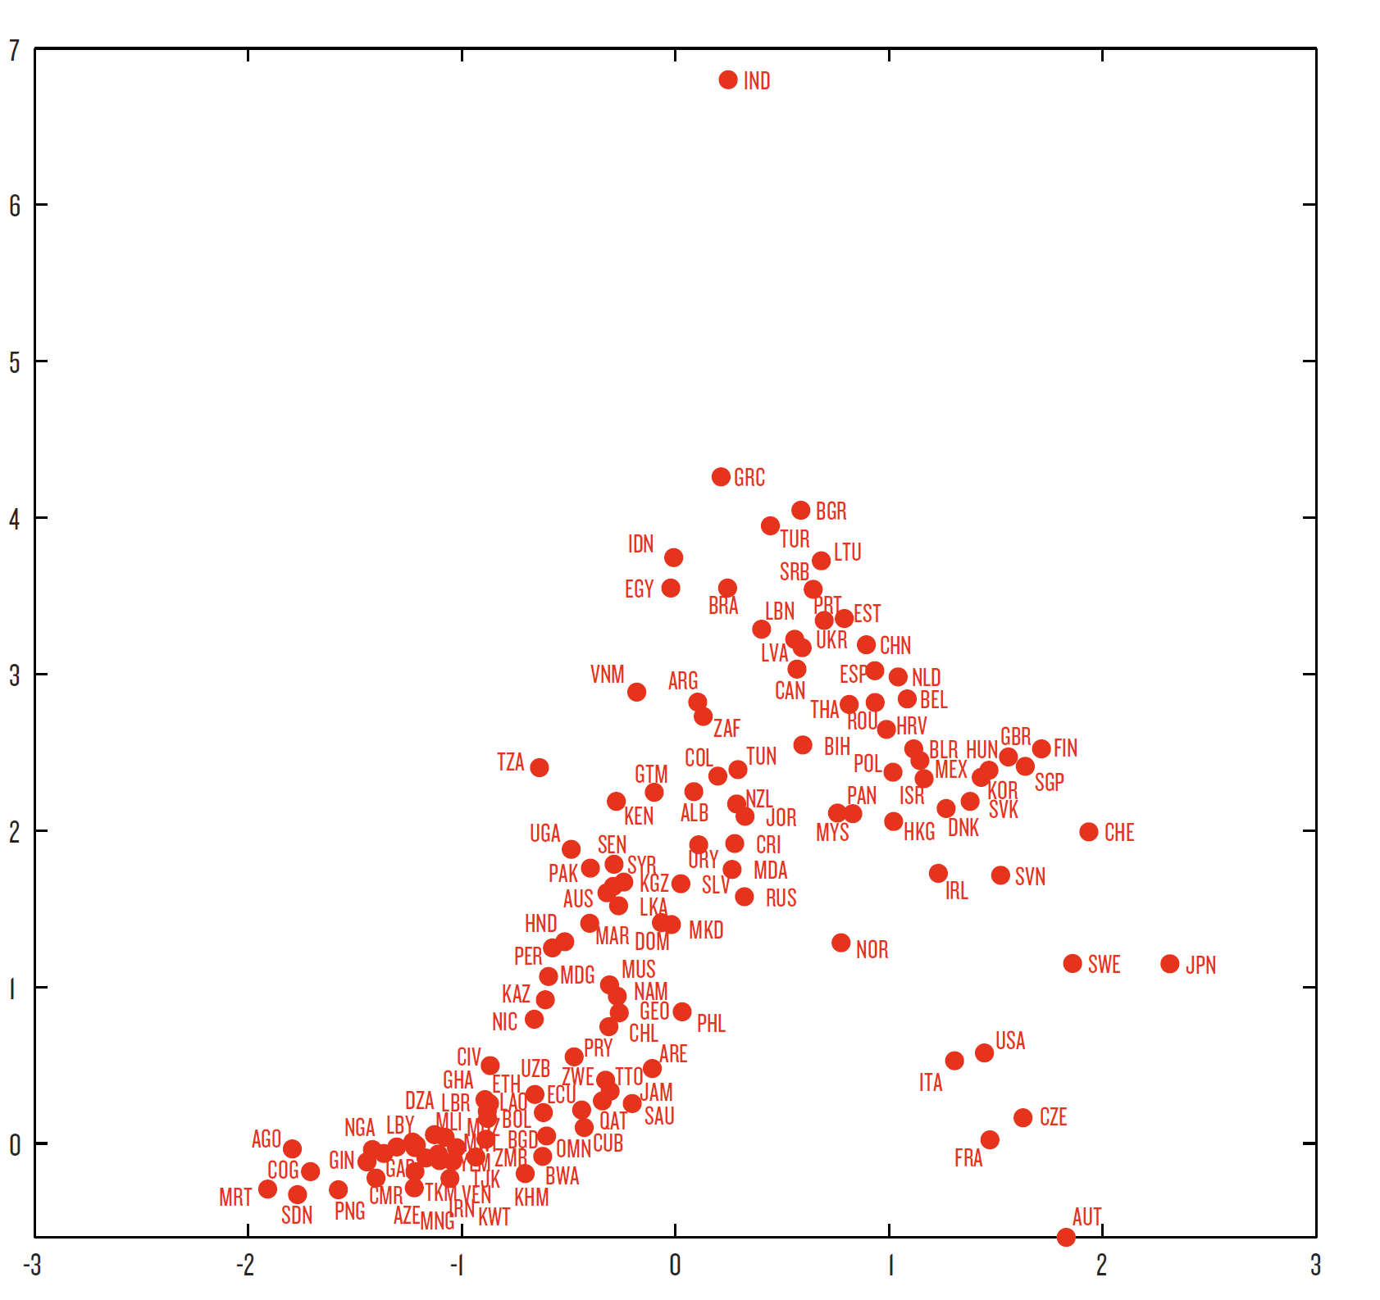
More personbytes
Easy to add more
Egypt
How close are
you to other
good products
in the product space?
Many personbytes
Hard to add more
by just copying others
Few personbytes
Hard to add more
How many personbytes (complexity) do you have now?

Slide 30
Combination of “deals” and “complexity/capability” determines joint dynamics of capability and growth
 | High Rent | Competitive
Export-Oriented | RENTIERS Iron ore, gold and diamond miners, tree crop with tax concessions, forestry | MAGICIANS Smallholder tree crops, specialized agriculture to Guinea and Ivory Coast
Domestic Market | POWERBROKERS Legislative monopolies or oligopolies (petroleum distribution, sectors protected for Liberian-only firms), Natural monopolies or oligopolies (beverages, cement), government services (driver’s licenses, U.S. dollars through the CBL) | WORKHORSES Most importers, traders, retailers, subsistence farmers, transporters, tailors, health care

Slide 31
Let’s revisit the “conventional wisdom” of coping with negative shocks
The “shorten the shock, borrow to smooth” might still be right….but there are three new questions:
  Can the existing “political settlement” that sustains the current “deals” environment for growth survive the shock? (e.g. Liberia)—Peru, for very recent instance
  Does the shock have negative long-run implications for your country’s current “capability” in the export product space? (e.g. is your country long in office real estate (metaphorically)—like tourism?)
  Can my country really borrow enough to not have to worry about the dynamics of the shock?

Slide 32
“Uncertainty” about what we don’t know is what gets us
Kay and King revisit Knightian/Keynesian “radical uncertainty”
“Puzzles” (probabilistic uncertainty) versus “mysteries” (“what is going on here”)
Make sure we don’t settle in on the “optimal” response from an economics of rich countries too soon—it might be right, but it is making huge underlying assumptions about the structure of politics/institutions and about production processes 9—so it also might be radically, catastrophically wrong

